Slide 1
The JavaScript Development Environment
Friday July 19: 10am – 12pm
Required software packages
Git & GitHub setup
Run your first JavaScript program

Slide 2
The JavaScript Development Environment
Required software packages
Friday July 19: 10am – 12pm
Visual Studio Code
Multi-language, extensible, lightweight Integrated Development Environment (IDE)
We’ll use it two write, test and debug complete JavaScript project: .js, .html, .css
Supports Git source control natively
We’ll use multiple VSCode extensions:
Live Server: web server running on your computer for debugging web projects
GitHub Pull Requests: integrates VSCode with git commands for team collaboration
Git
Source control system widely adopted in academia and industry.
Allows incremental development: small, verified code changes are keeping the whole project stable.
Allows team collaboration: multiple people contributed to same code base → open source projects.
GitHub
Cloud storage with a web-portal and functionality deeply integrated with git.
Create an account, no additional software necessary.

Slide 3

The JavaScript Development Environment
Git & GitHub setup
Friday July 19: 10am – 12pm
Create a GitHub account (if you don’t have one already)
Enter a valid email address ⟩ You’ll need to confirm a code sent to that email.
Answer to “How many team members will be working with you?” ⟩ Just me
Create your own work repository
In GitHub navigate to your account icon (upper right) ⟩ Your repositories ⟩ New
Choose a name ⟩ choose Private ⟩ click Add a README file ⟩ click
In the repository dashboard click on to locate the URL (identification) for this repository.
Clone your work repository into VSCode
Open VSCode. If you have any folder opened: File ⟩ Close Folder
Click on Git ( ) pane from the left icon bar, then
Enter the URL of your repository
Choose a location on your computer where the repository should synchronize.
Congratulations! You are all setup and ready to start coding!

Slide 4
The JavaScript Development Environment
Run your first JavaScript program
the setup validation
In your work repository in VSCode create a “HelloJS” directory
Create three files in that directory:
Create index.html ← copy in it the content from Index.html.
Create index.css ← copy in it the content from Index.css.
Create main.js ← copy in it the content from main.js.
Open your index.html file in your editor window.
Launch Live Server from the lower right corner of VSCode:
A browser window should appear, with the title “Hello JavaScript”.
Congratulations! Your startup web application is running!
You can always re-launch the app by going into any browser to this URL: http://127.0.01:5501/HelloJS/index.html
When Live Server is running, VSCode shows its port in lower right corner:

Slide 5
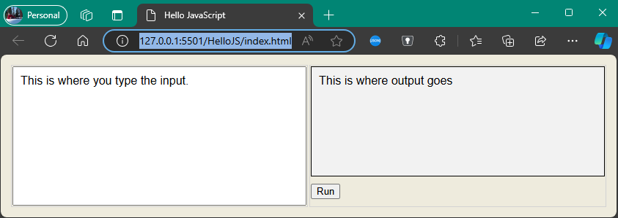
The JavaScript Development Environment
Run your first JavaScript program
the setup validation
HelloJS web application:
The text you entered should be added as a new line here.
Input any text here
The page is organized as a table covering 100% of the page area. It contains one row and two columns:
First column: input area
Second column: output, followed by the Run button.
The Run button area is 40 pixels tall, the output area covers the rest of the column width and height.
Click this button
Can you identify which parts of the code are controlling the web page layout?

